Slide 1


By
Let's talk NativeScript
This changes everything!

Slide 2

So you want to build a Mobile App?

Slide 3



Your zen is lost quickly ..
Too many platforms
Too many pitfalls with Native or Hybrid Apps
Confused Developer = Sad Panda!

Slide 4

So why NativeScript? {N}

Slide 5
Truly Native Apps with JavaScript

Slide 6



Wait .. What?
{ }
Native iOS / Andoid / Windows Phone* Apps Built with JavaScript + CSS + XML
Single Code Base
You're Welcome!
*Coming Soon

Slide 7
Tell me more ..

Slide 8
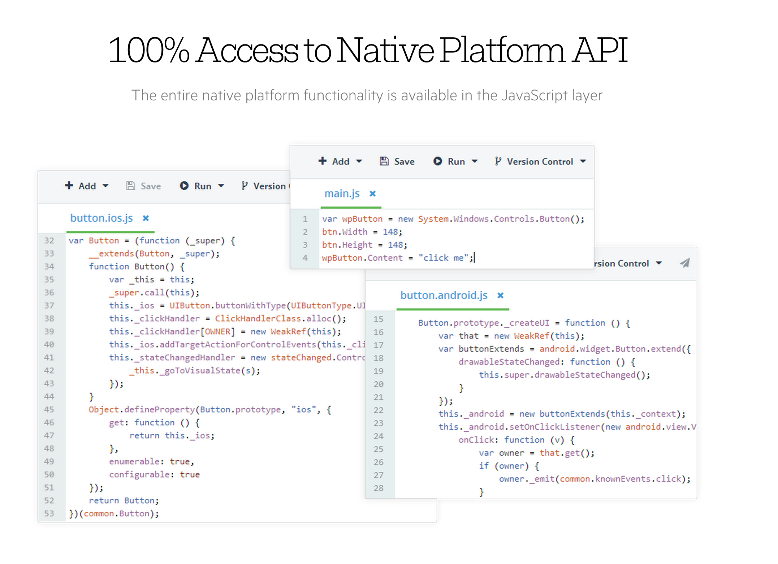

Slide 9
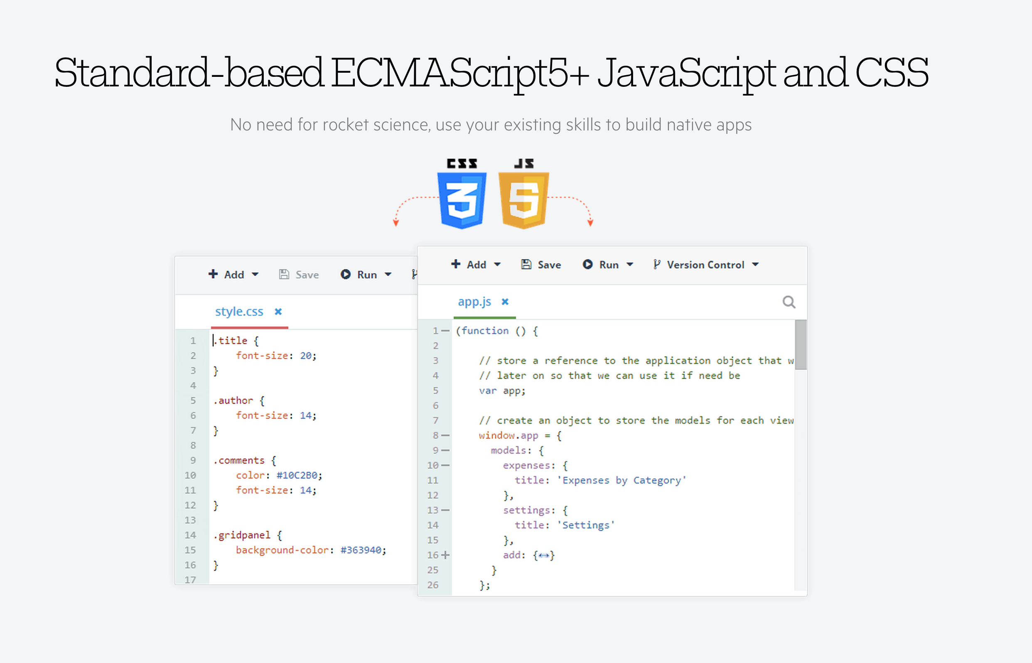

Slide 10
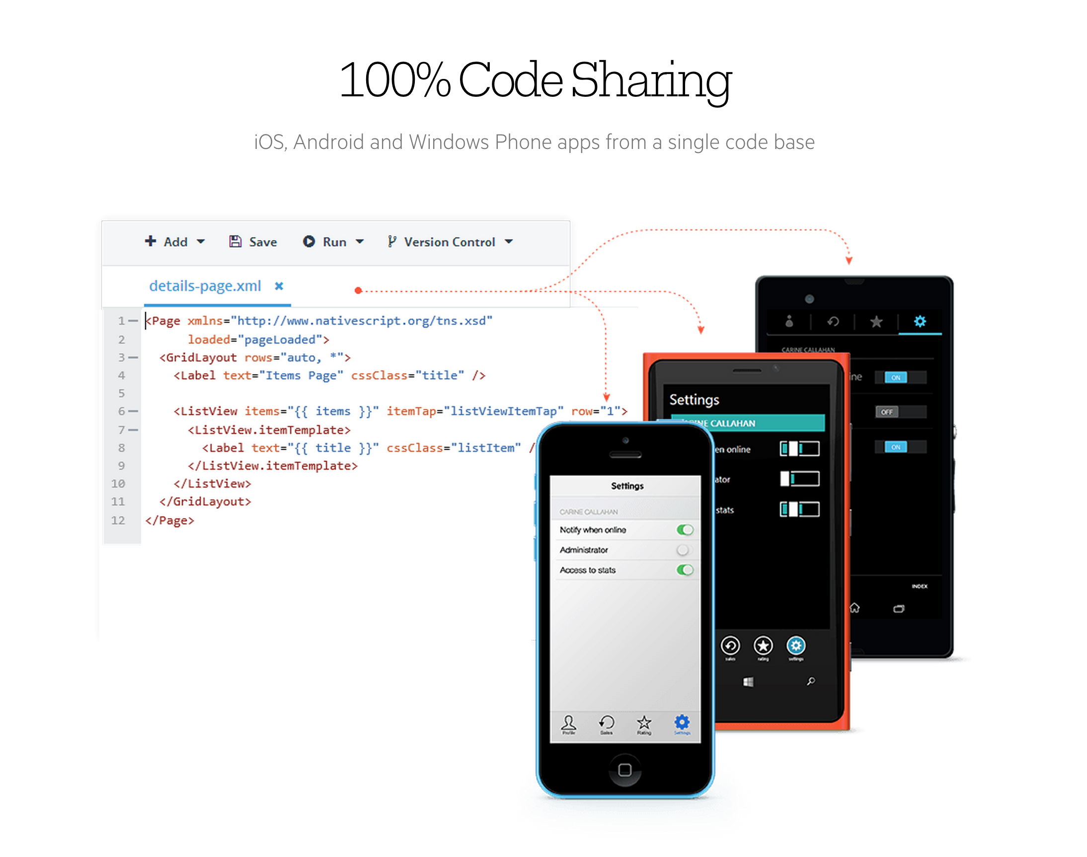

Slide 11
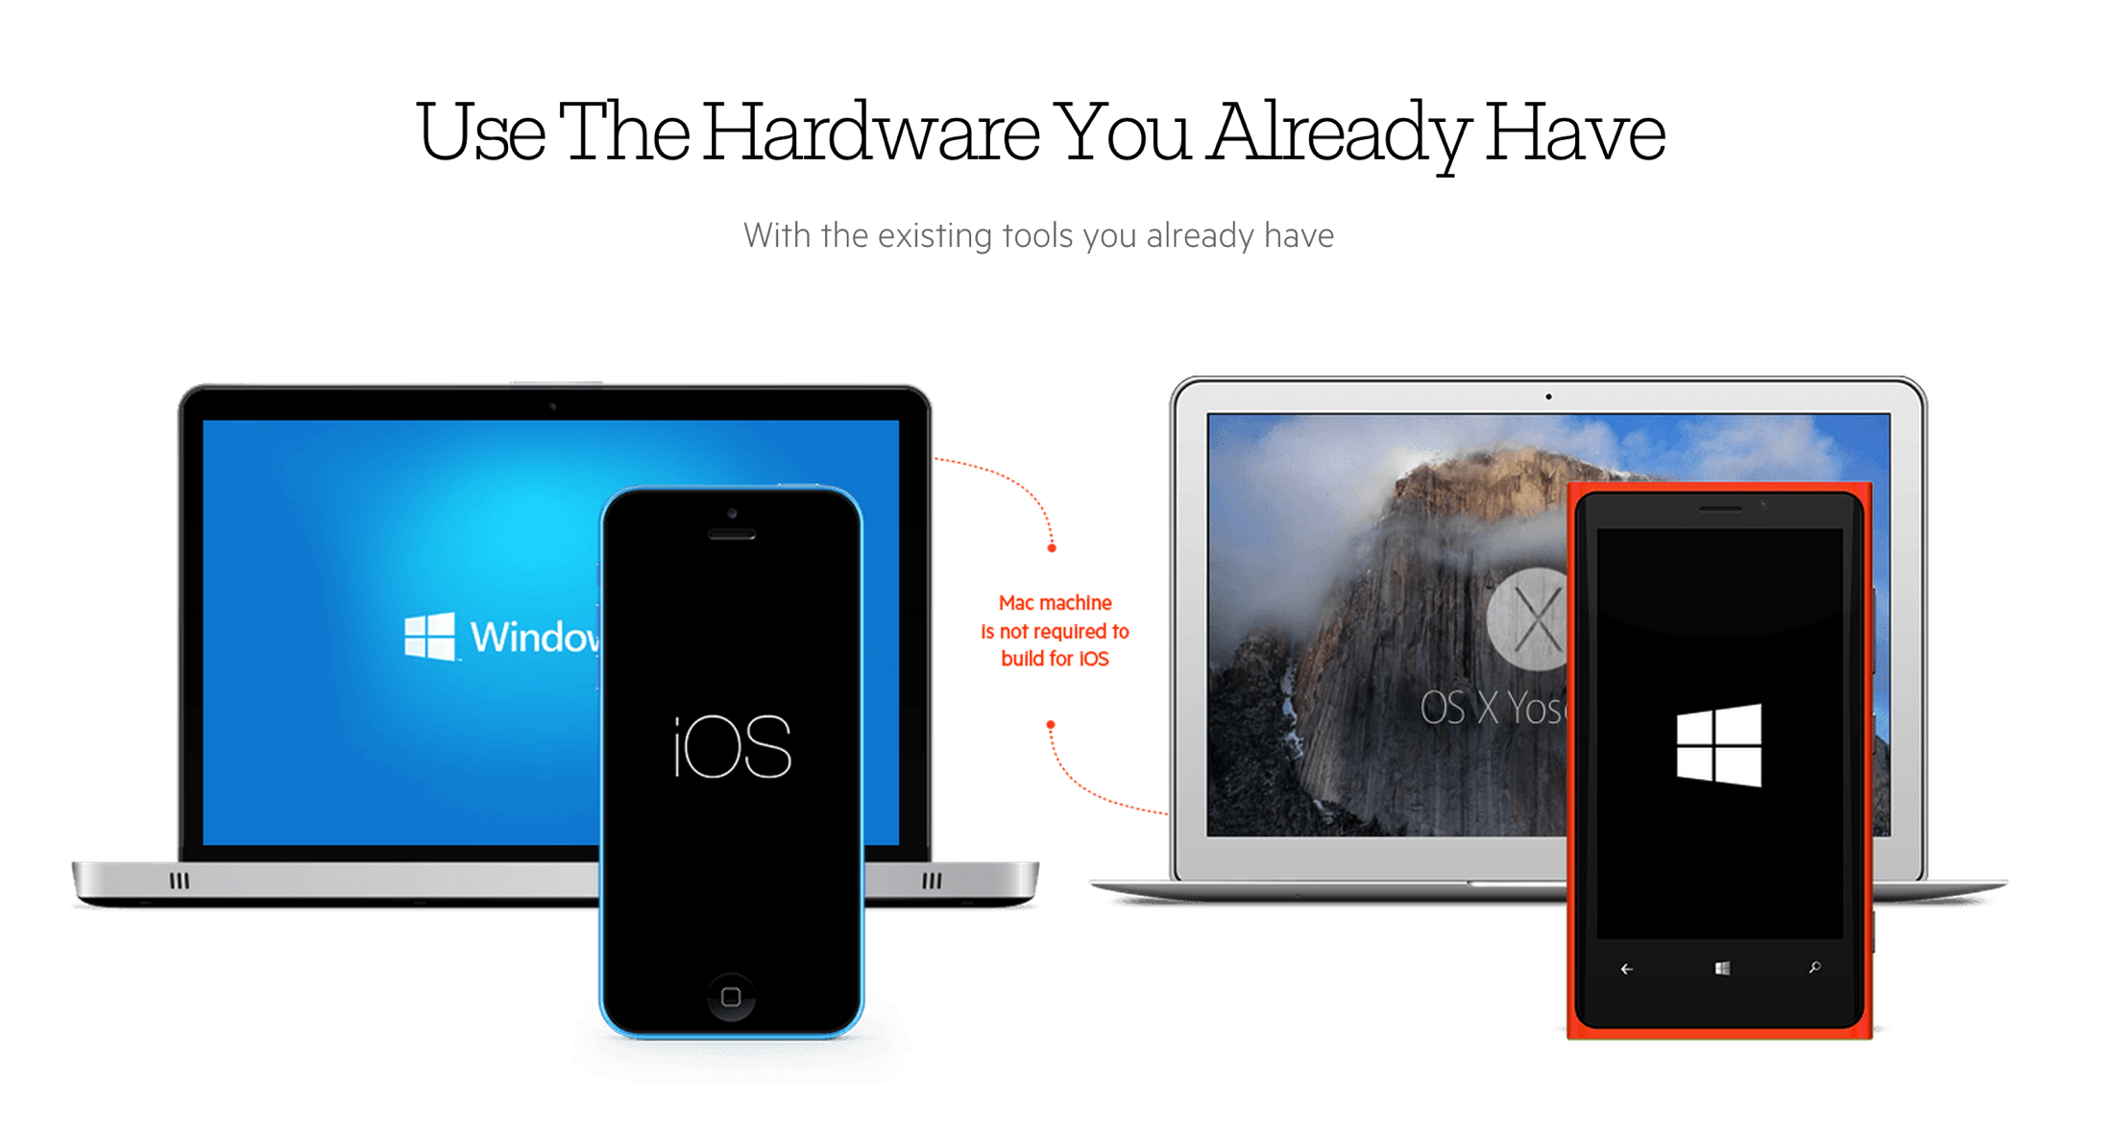

Slide 12
This is mind blowing ..
Yeah, it's careful orchestration.
Let's unpack the Magic!

Slide 13




How is this working?
{N} is built from ground up
No DOM
No Cross-Compilation
No Plugins Required
{N} is straight-up JS | Running as Native App

Slide 14



Under the hood
{N} works over an abstraction - a very smart one
Runs JavaScript in a Virtual Machine
JavaScriptCore VM on iOS V8 VM on Android
JavaScriptCore* VM on Windows Phone
*Tentative

Slide 15




You write JavaScript
{N} utilizes a bridge
Has full access to Native APIs
- That's all of iOS + Android APIs!
Uses Reflection to look up Native APIs List of APIs for each Platform Metadata pre-generated
Injected into App package @ Build time

Slide 16



Plug & Play?
{N} is very flexible
Allows reuse of skills & assets
Use native libraries for each platform
Use JS libraries without DOM dependency Shared UI styles through CSS
Full TypeScript Support

Slide 17
Think I'm sold .. where to start?
{N} gives you flexibility
You get 2 ways to start and choice of IDEs!

Slide 18

We LOVE Open Source
Choice #1: {N} is OSS on GitHub
Start @ https://www.nativescript.org/
Check out | Use it | Fork it
https://github.com/NativeScript/NativeScript
Yep, it's completely FREE .. there is no catch!

Slide 19
How do I start?
{N} Command Line Interface makes it easy Grab the NativeScript CLI:
npm install -g nativescript
Create Project & Add Platforms:
tns create MyApp
tns platform add android
Run Project on Device or Emulator:
tns run android
tns run android --emulator

Slide 20



Choice of IDE?
{N} aims to give you flexibility
Sublime Text | With complete Workflow
VS Code | Best for TypeScript Most other JS/CSS text editors

Slide 21

Use Telerik Platform
Choice #2: {N} is best with Telerik AppBuilder
- Start @ http://platform.telerik.com!
Complete end-to-end Mobile developer Platform!

Slide 22

What's in Telerik Platform?
Everything you need to build a Mobile app
AppPrototyper
AppBuilder
Backend Services
Mobile Testing
AppManager
AppFeedback
Analytics
Modulus
You'll love AppBuilder with {N}
All the pieces nicely wrapped up in one Platform!

Slide 23
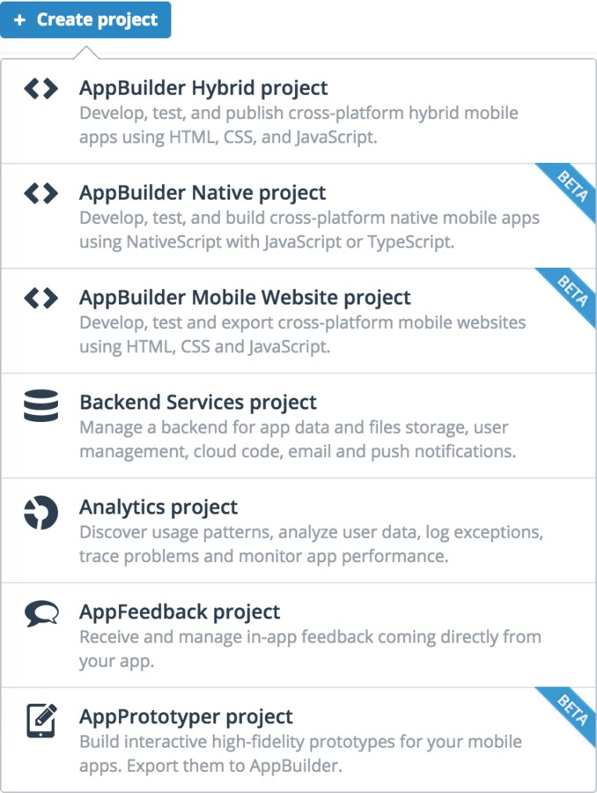
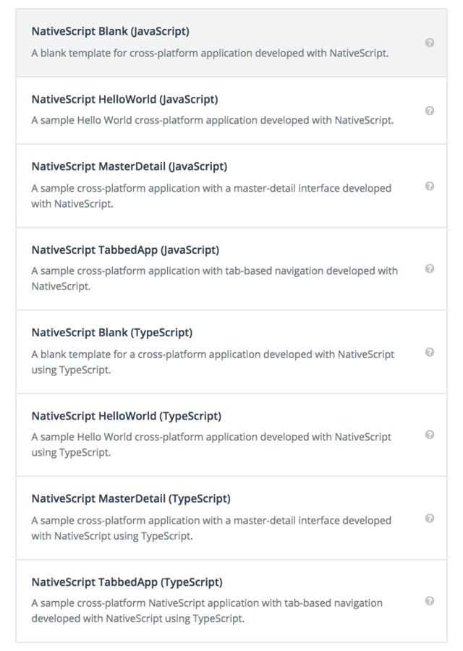
{N} in AppBuilder
Think of it as a friend with benefits
You gain Project Templates, Cloud Builds, Debugging & much more ..

Slide 24
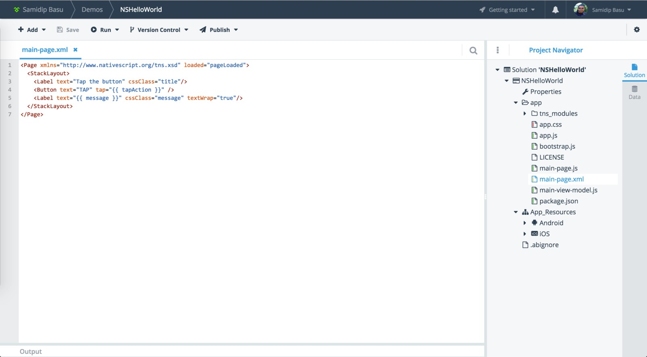
{N} Dev in a Browser
AppBuilder In-Browser Client is rather powerful
Of course, this isn't the only option .. pick your IDE!

Slide 25
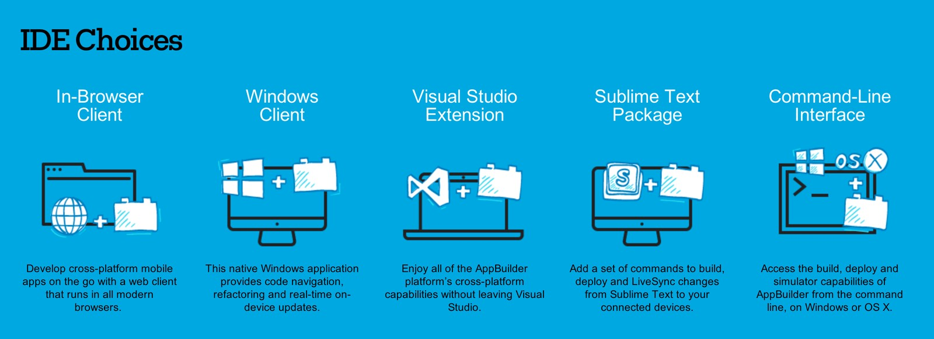
Telerik AppBuilder IDEs
{N} truly shines in Developer flexibility
Any Platform to suit your Mobile dev needs!

Slide 26
What about UI Composition?
Yes XML - it's Shared & X-Platform!
Think of it as lowest common denominator

Slide 27
Show me some UI
{N} uses XAML-like XML
<Image source="{thumbnailImageSource}" width="72" height="72"/>
<Label text="{itemTitle}" textWrap="true" cssClass="title" />
<Button text="{authoredBy}“ width="150“ cssClass="author"/>
You build a Visual Tree Just like XAML/HTML
You get UI elements & Container controls
These become Native UI .. little Magical!

Slide 28
Is the UI smart?
{N} supports Rich DataBinding
<Image | source="{thumbnailImageSource}"
 | width="72"
 | height="72"
<Label | verticalAlignment="top"/> text="{{ num_comments ? num_comments | + ' comments' : '' | }" | />
XAML-like Data Binding Off course .. it's 2-Way
Renders Adaptively for each platform
Data Binding powered by Polymer Expressions!

Slide 29
How do I style the UI?
{N} uses the ubiquitous CSS .. hallelujah
<Page loaded="load">
<Label text="{{ message }}" />
</Page>
.Label {
color: red; font-size: 20;
margin: 20;
}
Yep - CSS to style Mobile App elements!
We know you're a CSS ninja .. now use it.

Slide 30
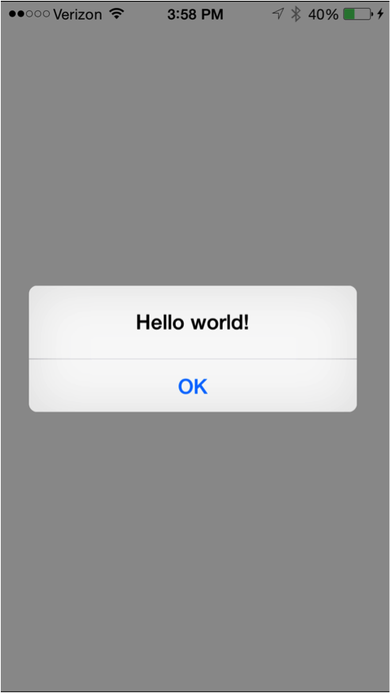
Can I invoke Native UI?
{N} supports Native UI element instatiation
var alert = new UIAlertView(); alert.message = "Hello World"; alert.addButtonWithTitle("OK"); alert.show();
Native UI
Invoked through JS!

Slide 31
What makes up a {N} Project?
You're asking all the right questions ..
Combination of UI, Logic, Styling & Modules!

Slide 32
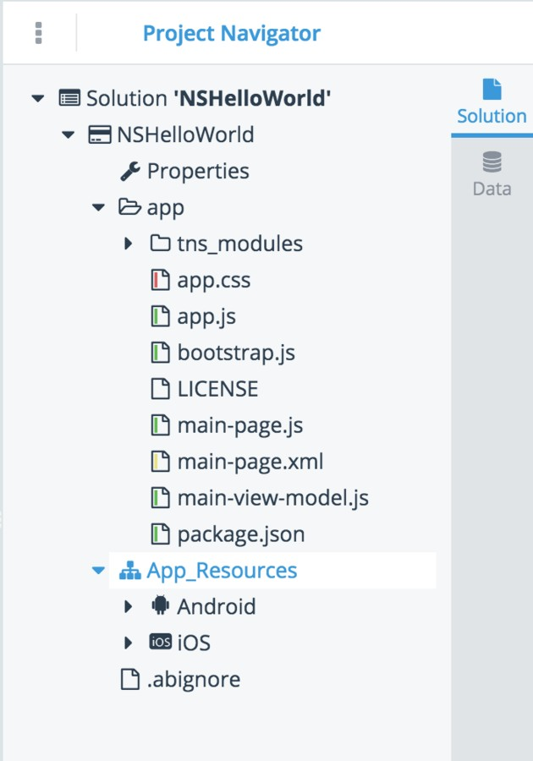
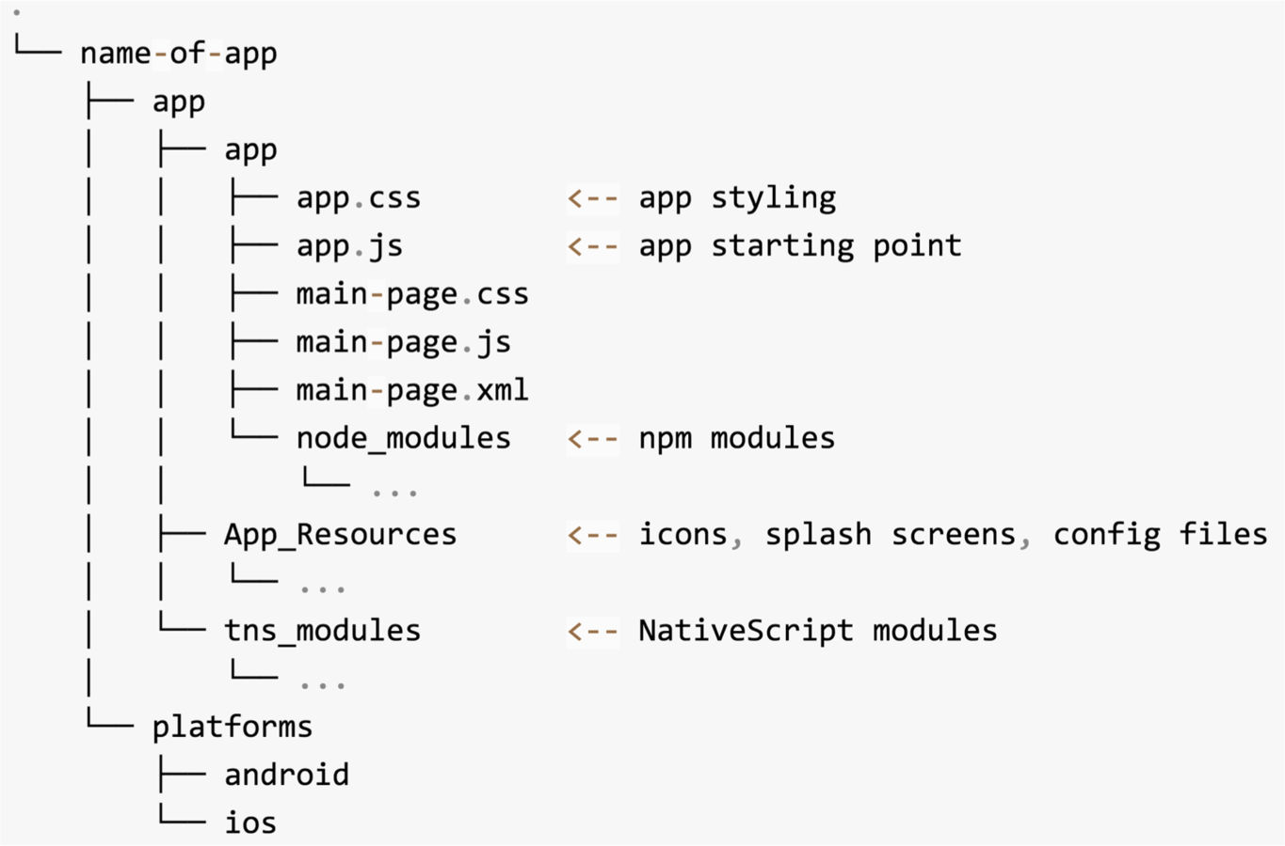
A Typical {N} Project
All your components in one place
They say a picture is worth a 1000 words ..

Slide 33
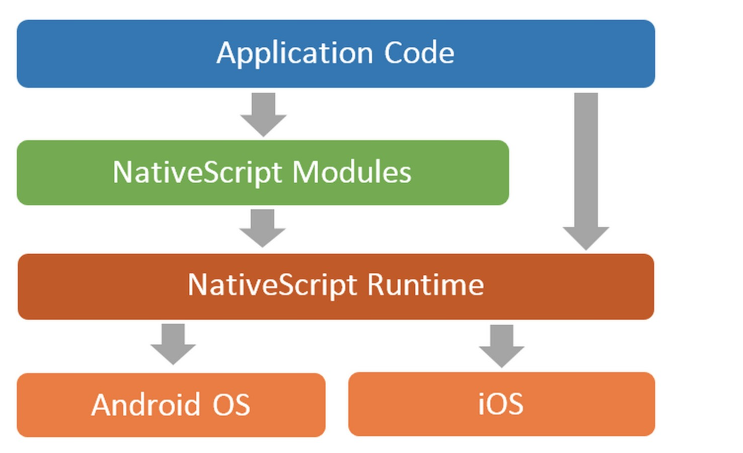
What's a Module?
{N} bridge that takes functionality X-Platform
Just like a Node module
Dozens available | You can write custom modules

Slide 34
Show a Module in action
{N} allows you to bring in what's needed
var http = require("http"); http.getJSON("https://api.myservice.com")
.then(function(result){
// result is a JSON object
// do stuff
});
This is a generic HTTP Module
Works the same way in each Platform

Slide 35
Module to Native
{N} does the mapping .. so you don't have to
var fileSystem = require("file-system"); new fileSystem.File(somePath);
Translates this as ..
new java.io.File(somePath);
Translates this as ..
NSFileManager.defaultManager(); fileManager.createFileAtPathContentsAttributes(somePath);

Slide 36
You had me at Native with JS!
Yeah, we're just as excited.
There is a lot we covered though ..

Slide 37
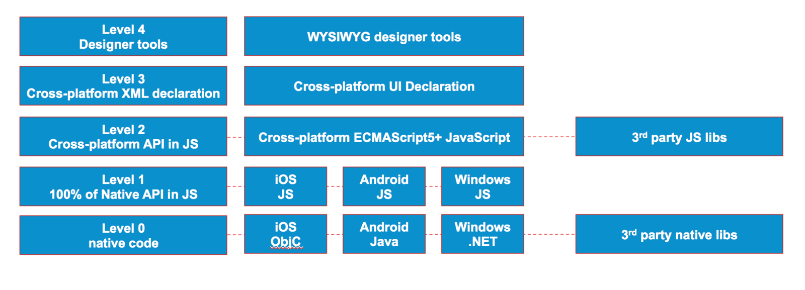

Gimme a 10K Feet View
Here you go .. the layers of {N} magic!
{N} also sports integrated support with Angular 2!
Reuse your Web & TypeScript skills ..

Slide 38
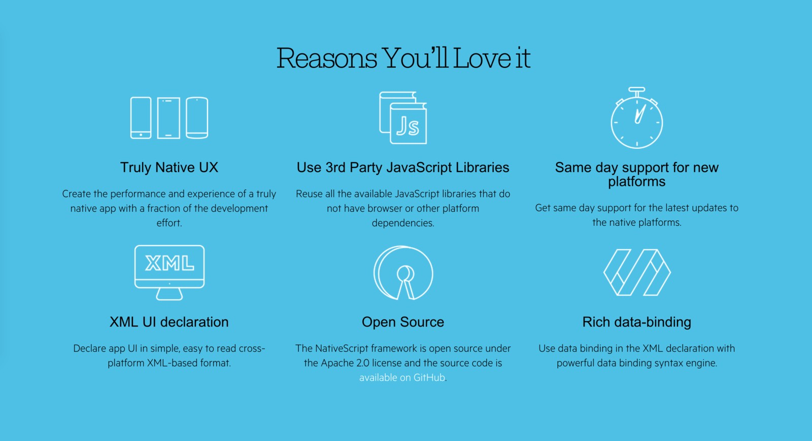
Why {N} again?

Slide 39

You're a Mobile Ninja
{N} is here to help!

Slide 40



Feel the Native Zen
Tooling that elevates X-Plat Mobile
Getting Started
{N} with Telerik Platform App Showcase
Solid Docs | Forums Contribute Back

Slide 41
Go build your dream app!
By
Native X-Platform Mobile with JS
NativeScript Blog | @NativeScript

